Slide 1
OPEN SOURCE TOOLS FOR DATA SCIENCE PROJECT:
TOPIC: Eco-friendly Energy Usage Prediction: Predict household energy consumption patterns to recommend eco-friendly practices.
Presented by: Preinel Silford Abreu(23030124211)
Joel Mathew(23030124234)

Slide 2
Index
1) Problem Statement and Objective
2) Data Collection
3) Data Preprocessing
4) Exploratory Data Analysis(EDA)
5) Model Training & Prediction
6) Model Evaluation
7) Conclusion

Slide 3
Problem Statement
Objective
Household energy consumption is increasing.
Excessive usage leads to higher carbon emissions.
There is a need to predict energy consumption patterns.
Goal: Build a regression model to predict energy usage.
Perform exploratory data analysis (EDA)
Optimize the program
Apply multiple regression models
Compare performance using R² and MAE
Identify the best-performing model

Slide 4
Data Collection
smart_home_energy_consumption_large.csv
Home ID | Appliance | Energy Consumption(kwH) | Time | Date | Outdoor Temperature(C) | Season | Household Size
94 | Fridge | 0.2 | 21:12 | 02-12-23 | -1 | Fall | 2
435 | Oven | 0.23 | 20:11 | 06-08-23 | 31.1 | Summer | 5
366 | Dishwasher | 0.32 | 6:39 | 21-11-23 | 21.3 | Fall | 3
The dataset consists of 8 columns and 100k records. It consists of HomeID(int), Appliance(String), Energy Consumption(float), Time, Date, Outdoor Temp(float), Season(String) and Household Size(int). The target variable is Energy Consumption(kwH)

Slide 5
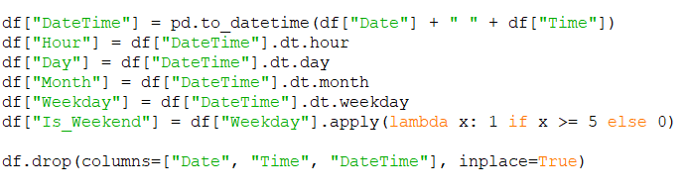
Data Preprocessing
Checked missing values
Converted Date & Time into DateTime format
Converted raw date/time into structured numerical features

Slide 6
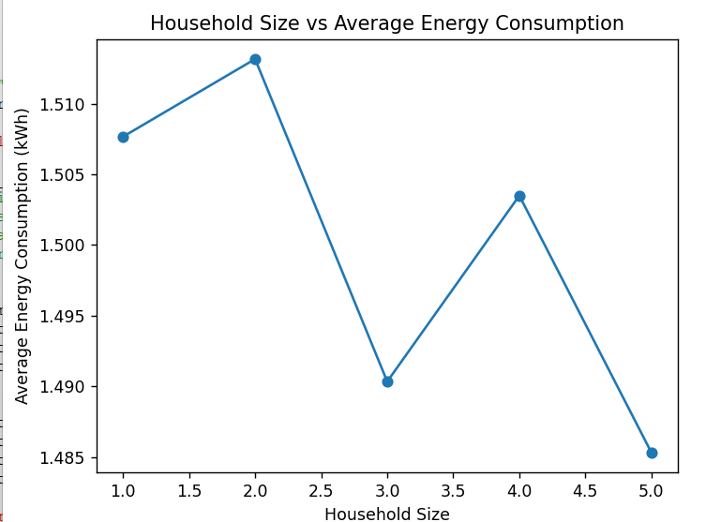
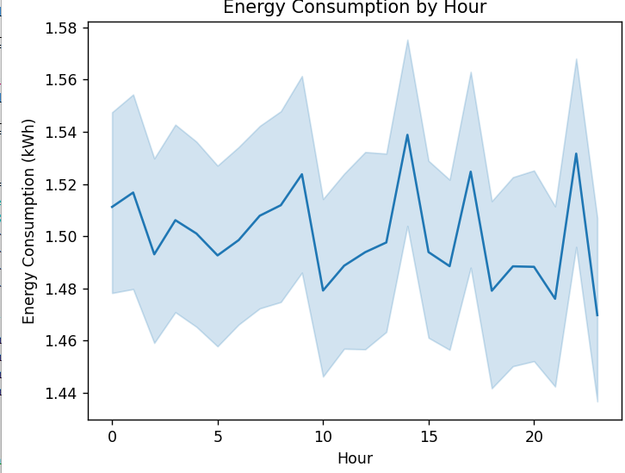
Exploratory Data Analysis
Household size does not strongly affect consumption.
Different hours have different energy consumption

Slide 7
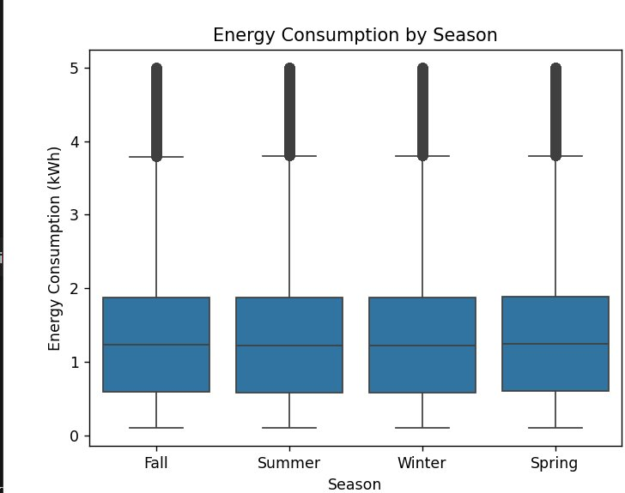
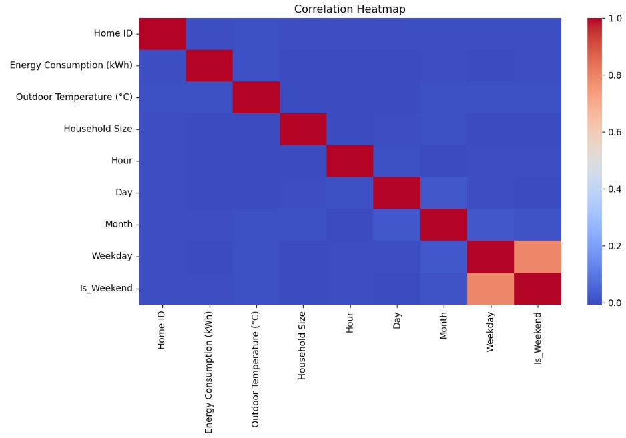
Exploratory Data Analysis
Similar energy consumption across all seasons.
Energy consumption does not have strong linear dependence on any single variable.

Slide 8
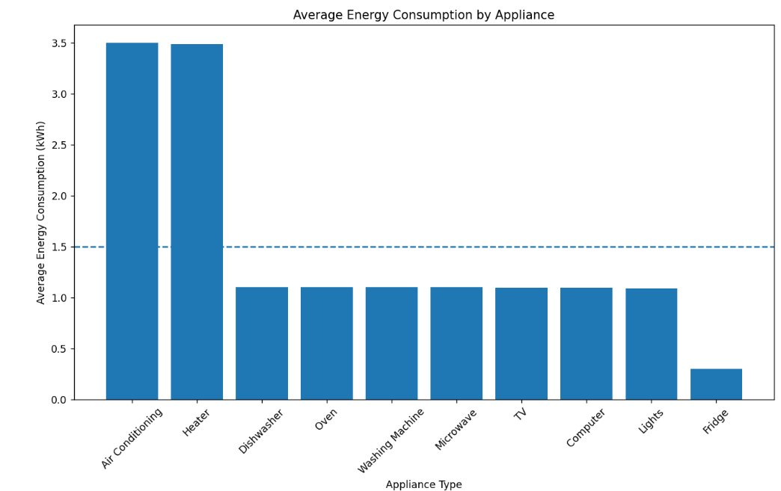
Exploratory Data Analysis
Overall average energy consumption is 1.5kWh, however, Air Conditioning and Heater takes more than the average consumption at 3.4kWh.

Slide 9
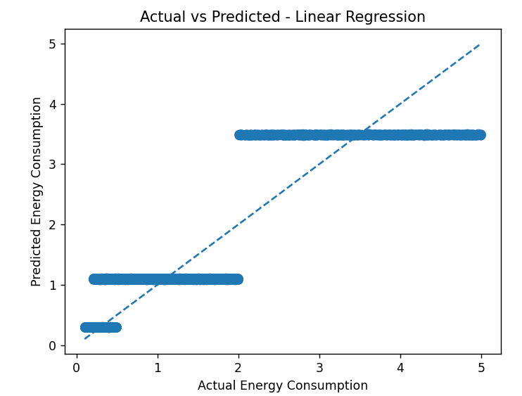
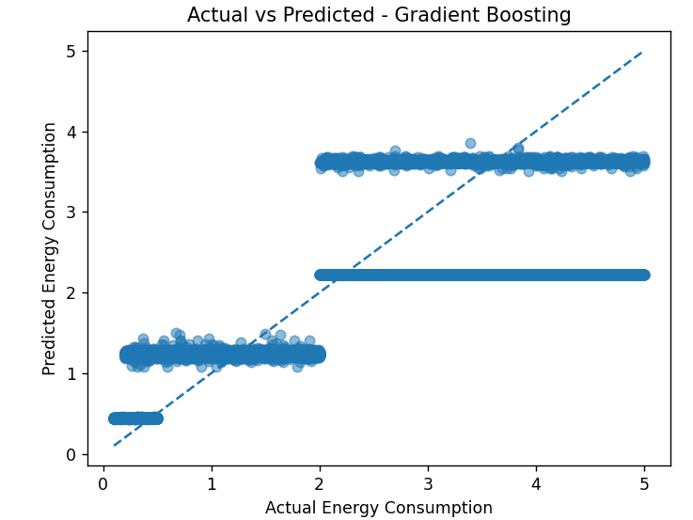
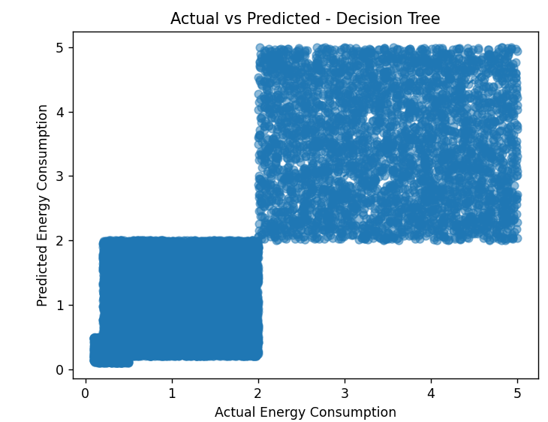
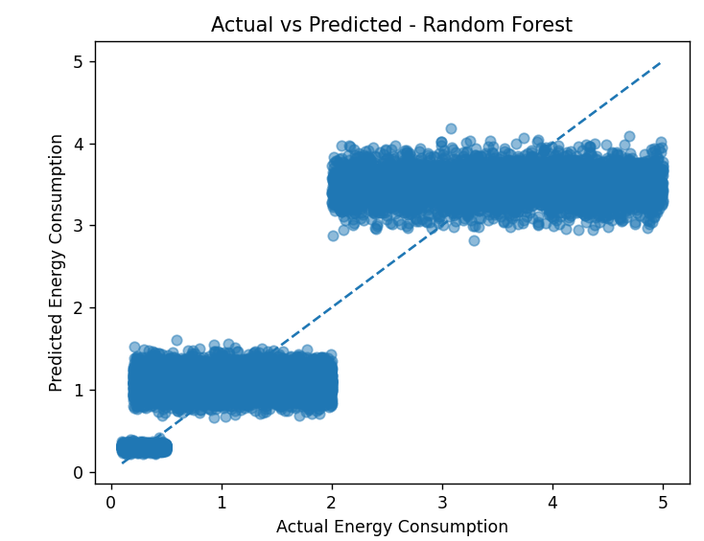
Model Training & Prediction
The models used are: Linear Regression, Decision Tree regressor, Random Forest regressor, Gradient Boosting regressor.
80% data is used for training and remaining 20% data for testing.

Slide 10
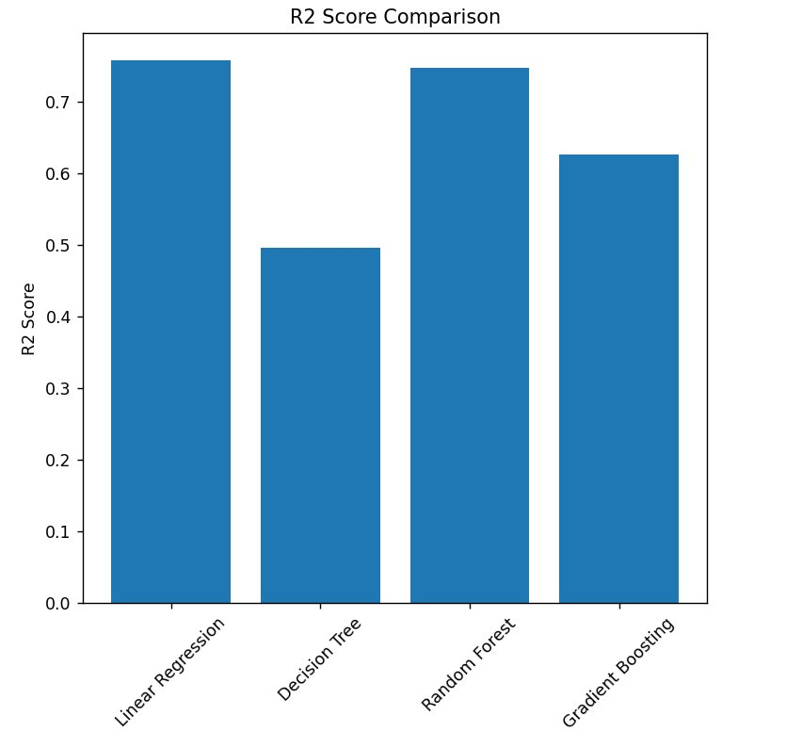
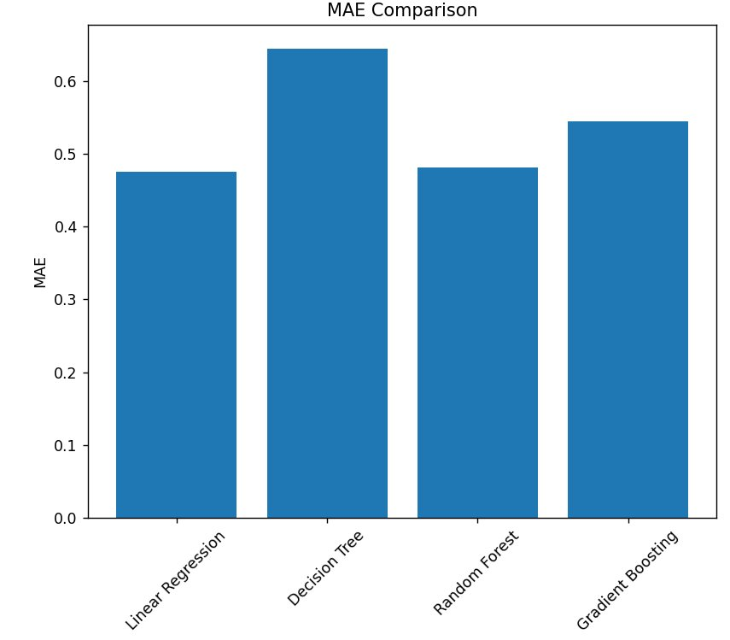
Model Evaluation

Slide 11
Conclusion
Increased energy consumption has led to higher carbon emission which needs to be addressed
Dataset has 8 columns and 100k rows, was preprocessed and EDA was performed.
Household size does not strongly affect consumption. Different hours affect energy consumption differently. Seasons have a less effect on consumption. No single feature strongly affects energy consumption.
Heater and AC consumes more than 2x the average energy than other appliances
Time-based features (Hour, Weekend) provided useful behavioral patterns.
Compared Linear Regression, Decision Tree, Random Forest, and Gradient Boosting.
Highest R² and Lowest MAE is Linear Regression

Slide 12
Thank you

